Slide 1

EASYCHEF
Ronan Green
Recipe Generator Mobile App

Slide 2

Introduction
Application Overview
Problem Statement
Value Proposition
Target Market
Research
Features
Conclusion

Slide 3
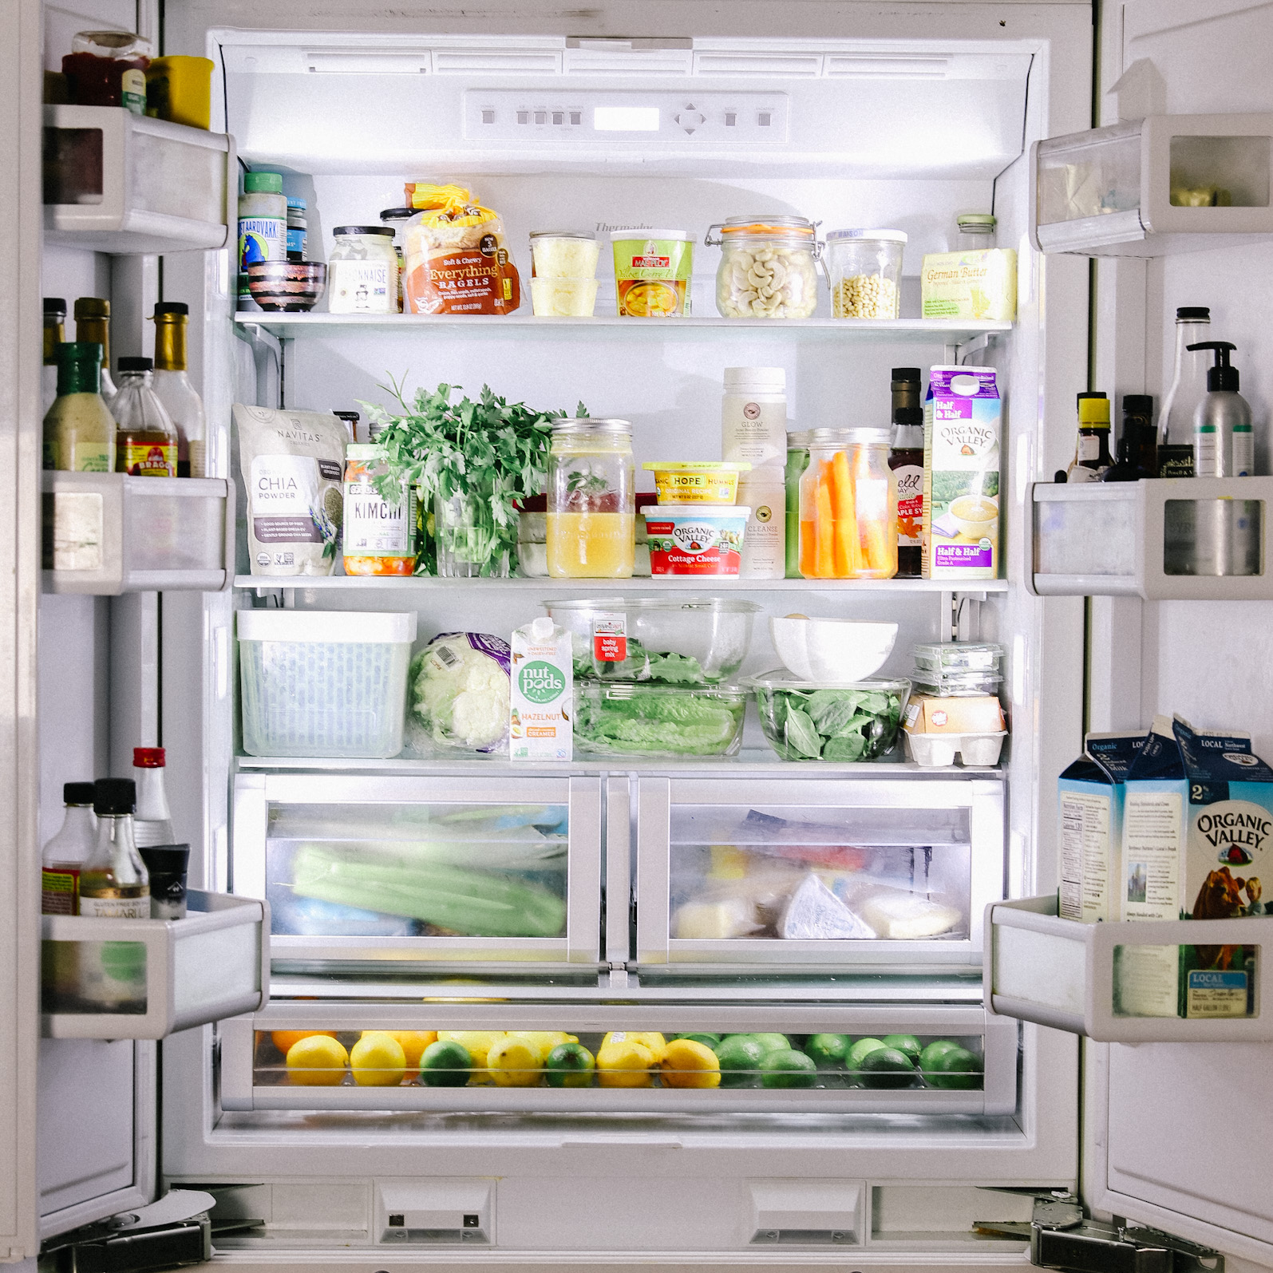
Application Overview
Uses AI and Machine Learning to simplify meal prep and cooking.
Ingredient Identification.
AI generates recipes and shopping lists from user's food trends.
Objectives:
Simplify cooking
Save time in preparation
Improve ingredient utilisation

Slide 4
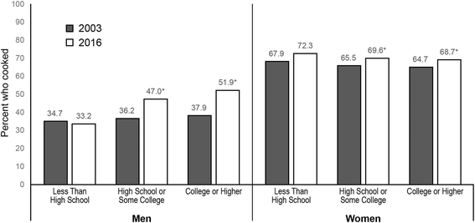
Problem Statement
Busy Schedules.
Rise in home cooking.
Takeaways remain popular.
Significant to Irish cultural heritage.

Slide 5
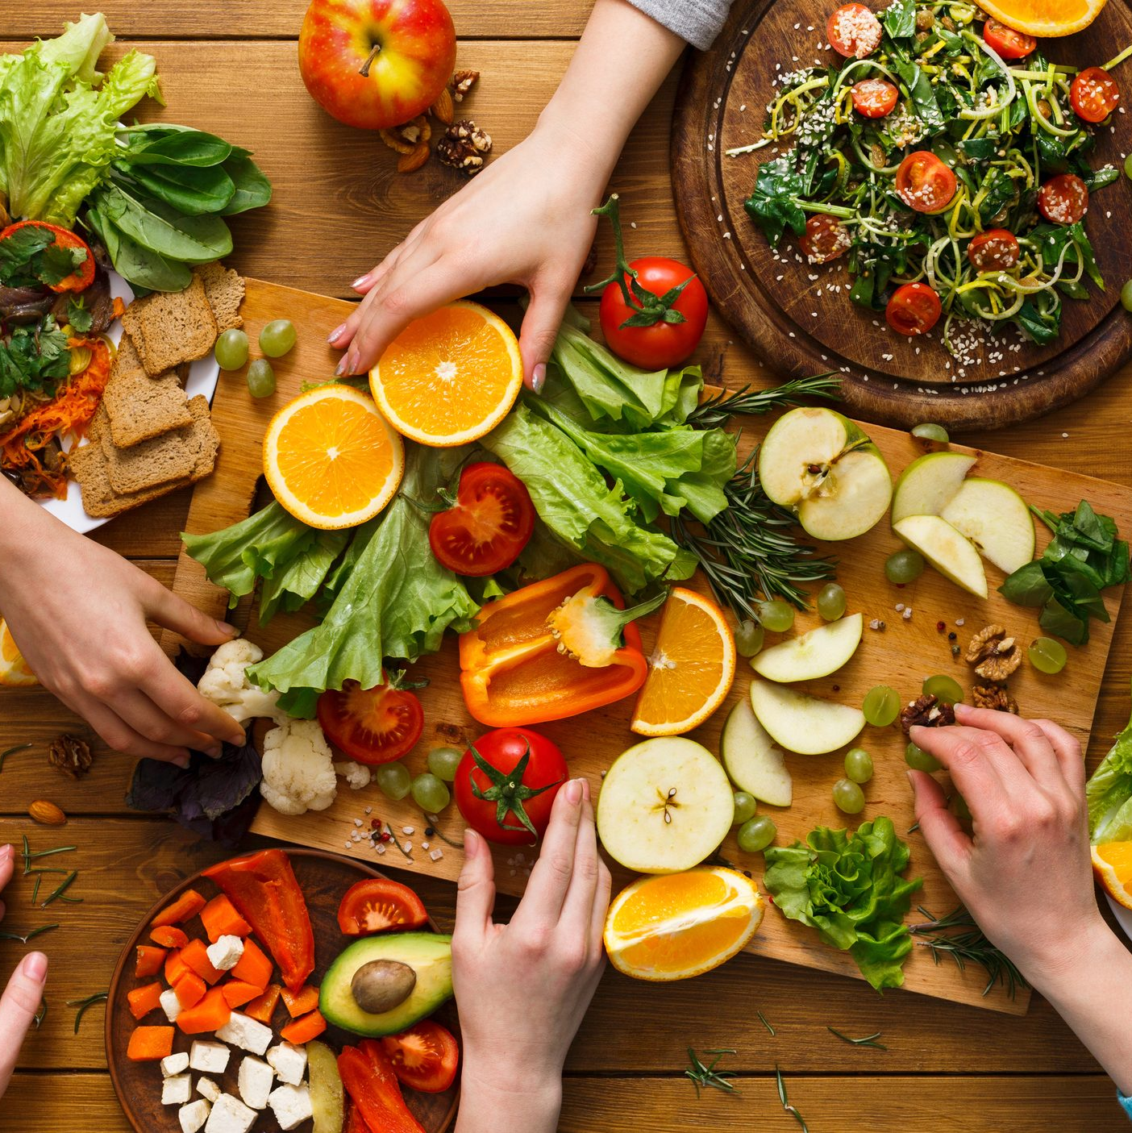
Value Proposition
Simplifies meal planning.
Optimises ingredients usage.
Suggests healthier option.
Facilitates:
Creation of shopping lists
Finding new recipes

Slide 6
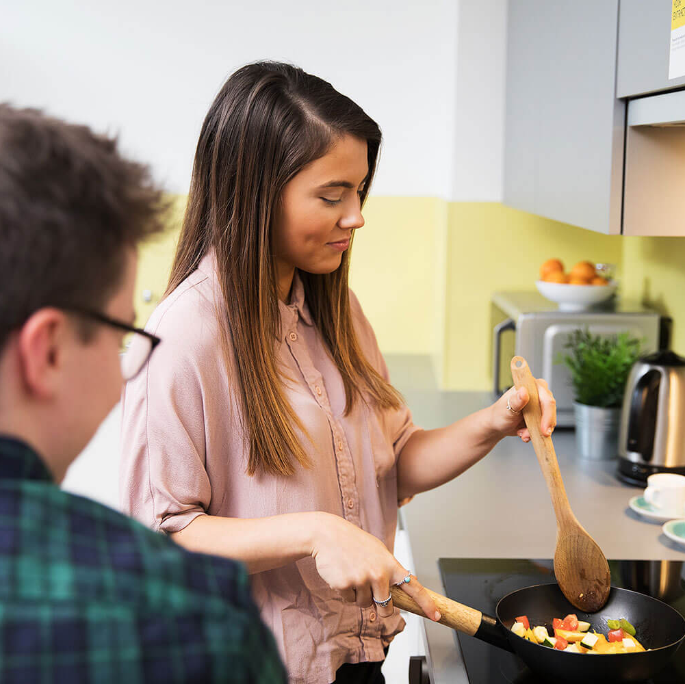
Target Market
EasyChef will target:
Busy indivudals with limited time
Students on a budget
Health-oriented individuals
People seeking ease in cooking
Will attract:
Those who want to minimise food waste
Those searching for new, easy recipes

Slide 7
Research
Rise in home cooking:
A 4% increase among educated women and a 14% increase among men [1].
Home cooking increased by 42%, with 60% continuing this habit post-lockdown [2].
Takeaways as a common alternative:
Higher consumption in higher-income households [3].
New Zealand show takeaways have high energy content and low nutritional quality[4].
Cultural importance of home cooking in Ireland:
75% of Irish parents learned cooking skills from their mother [5].
Home cooking connects families to their food [6].

Slide 8

Features
EasyChef offers a variety of core features to streamline cooking and meal planning.
Core features include:
Ingredient identification through image recognition
Personalised recipe recommendations
Shopping list creation
Barcode scanning
Healthy alternative suggestions
AI Chatbot
User profile for customisation

Slide 9
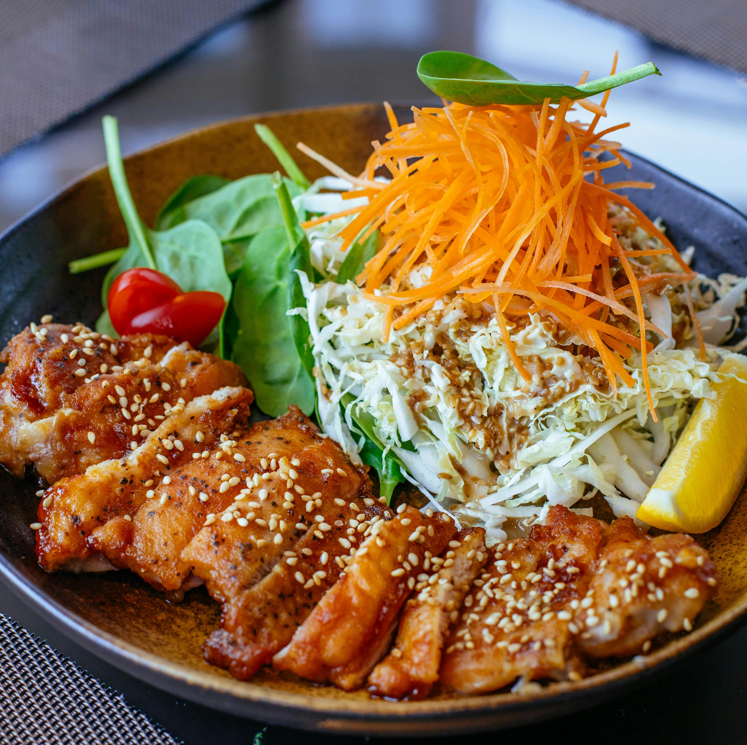
Conclusion
EasyChef is a meal planning application that uses AI and machine learning for daily convenience.
Features include:
Image recognition
Personalised recipes
Ingredient management
Provides an easy-to-use solution for cooking.
Offers a new meal preparation approach for:
Busy people
Students
Home cooks

Slide 10

Questions?

Slide 11
References
[1] Taillie, L.S. (2018). Who’s cooking? Trends in US home food preparation by gender, education, and race/ethnicity from 2003 to 2016. Nutrition Journal, 17(1). doi:https://doi.org/10.1186/s12937-018-0347-9. https://link.springer.com/article/10.1186/s12937-018-0347-9
[2] Sarda, B., Delamaire, C., Serry, A.-J. and Ducrot, P. (2022). Changes in home cooking and culinary practices among the French population during the COVID-19 lockdown. Appetite, 168, p.105743. doi:https://doi.org/10.1016/j.appet.2021.105743. https://www.sciencedirect.com/science/article/pii/S0195666321006504
[3] Turrell, G. and Giskes, K. (2008). Socioeconomic disadvantage and the purchase of takeaway food: A multilevel analysis. Appetite, 51(1), pp.69–81. doi:https://doi.org/10.1016/j.appet.2007.12.002. https://www.sciencedirect.com/science/article/abs/pii/S0195666307004308
[4] Mahawar, N., Jia, S.S., Korai, A., Wang, C., Allman-Farinelli, M., Chan, V., Raeside, R., Phongsavan, P., Redfern, J., Gibson, A.A., Partridge, S.R. and Roy, R. (2022). Unhealthy Food at Your Fingertips: Cross-Sectional Analysis of the Nutritional Quality of Restaurants and Takeaway Outlets on an Online Food Delivery Platform in New Zealand. Nutrients, 14(21), p.4567. https://www.mdpi.com/2072-6643/14/21/4567 https://www.mdpi.com/2072-6643/14/21/4567
[5] McCloat, A., Mooney, E., & Hollywood, L. E. (2017). Have Irish parents put cooking on the back burner? An Island of Ireland study of the food skills, cooking confidence and practices of parents. British Food Journal, 119(5), 992-1002. https://doi.org/10.1108/BFJ-09-2016-0440 https://www.emerald.com/insight/content/doi/10.1108/BFJ-09-2016-0440/full/html
[6] Simmons, D., & Chapman, G. E. (2012). The significance of home cooking within families. *British Food Journal, 114*(8), 1184-1195. https://doi.org/10.1108/00070701211252110 https://www.emerald.com/insight/content/doi/10.1108/00070701211252110/full/html

